Slide 1
Polymorphism
Inheritance allows you to define a base class and derive classes from the base class
Polymorphism allows you to make changes in the method definition for the derived classes and have those changes apply to methods written in the base class

Slide 2
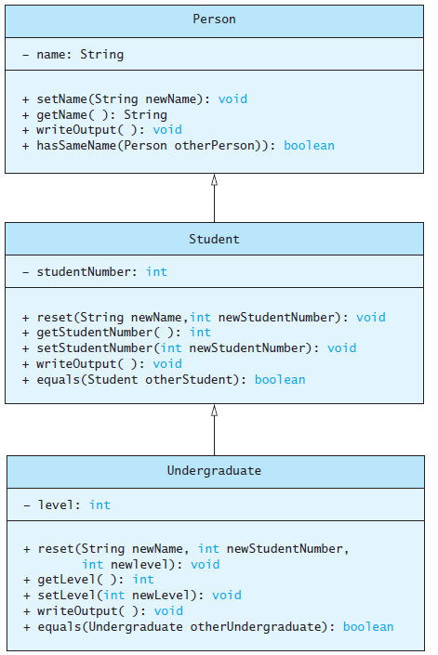
Polymorphism
Consider an array of Person
Person[] people = new Person[4];
Since Student and Undergraduate are types of Person, we can assign them to Person variables
people[0] = new Student("DeBanque, Robin", 8812);
people[1] = new Undergraduate("Cotty, Manny", 8812, 1);

Slide 3
Polymorphism
Given:
Person[] people = new Person[4];
people[0] = new Student("DeBanque, Robin", 8812);
When invoking:
people[0].writeOutput();
Which writeOutput() is invoked, the one defined for Student or the one defined for Person?
Answer: The one defined for Student

Slide 4
An Inheritance as a Type
The method can substitute one object for another
  Called polymorphism
This is made possible by mechanism
  Dynamic binding
  Also known as late binding

Slide 5
Dynamic Binding and Inheritance
When an overridden method invoked
  Action matches method defined in class used to create object using new
  Not determined by type of variable naming the object
Variable of any ancestor class can reference object of descendant class
  Object always remembers which method actions to use for each method name

Slide 6
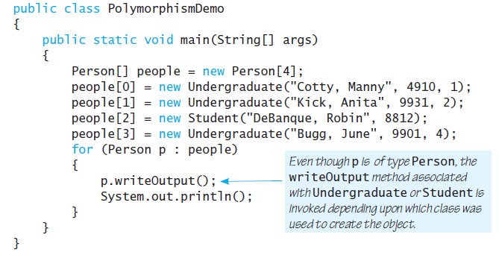
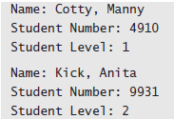
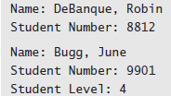
Polymorphism Example

Slide 7
Class Interfaces
Consider a set of behaviors for pets
  Be named
  Eat
  Respond to a command
We could specify method headings for these behaviors
These method headings can form a class interface

Slide 8
Class Interfaces
Now consider different classes that implement this interface
  They will each have the same behaviors
  Nature of the behaviors will be different
Each of the classes implements the behaviors/methods differently

Slide 9
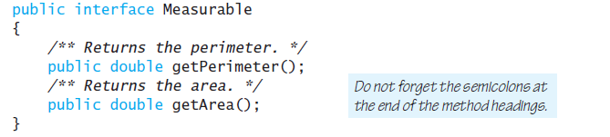
Java Interfaces
A program component that contains headings for a number of public methods
  Will include comments that describe the methods
Interface can also define public named constants
interface Measurable

Slide 10
Java Interfaces
Interface name begins with uppercase letter
Stored in a file with suffix .java
Interface does not include
  Declarations of constructors
  Instance variables
  Method bodies

Slide 11
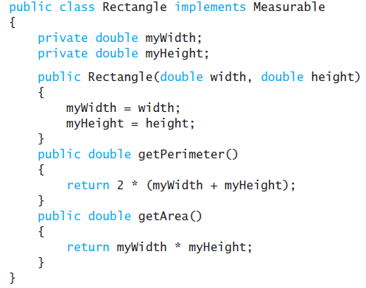
Implementing an Interface
To implement a method, a class must
  Include the phrase
  implements Interface_name
  Define each specified method

Slide 12
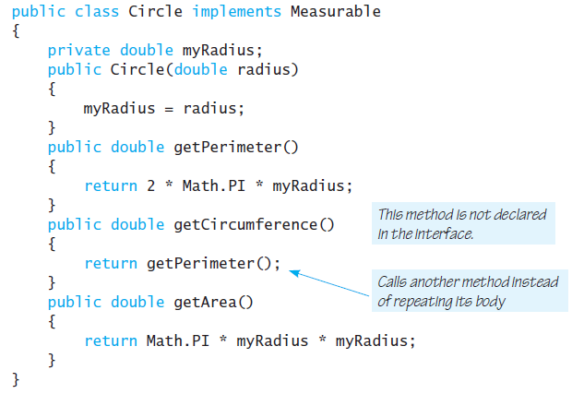
Implementing an Interface

Slide 13
An Inheritance as a Type
Possible to write a method that has a parameter as an interface type
  An interface is a reference type
Program invokes the method passing it an object of any class which implements that interface

Slide 14
Extending an Interface
Possible to define a new interface which builds on an existing interface
  It is said to extend the existing interface
A class that implements the new interface must implement all the methods of both interfaces

Slide 15
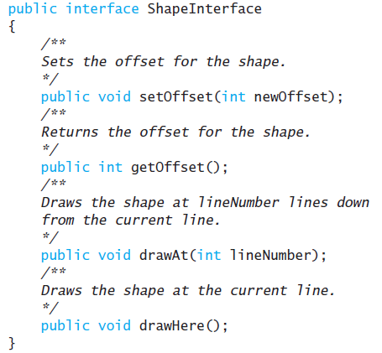
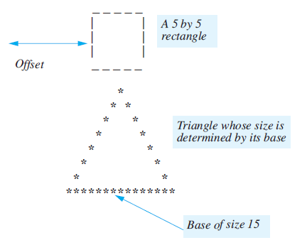
Case Study

Slide 16
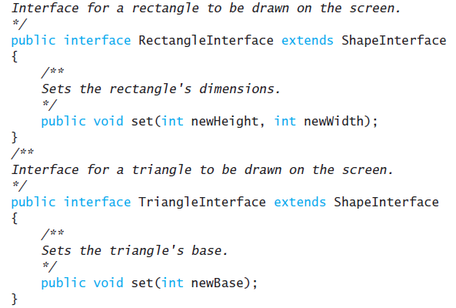
Case Study
If we wish to create classes that draw rectangles and triangles
  We could create interfaces that extend ShapeInterface

Slide 17
Case Study
class ShapeBasics
Note
  Method drawAt calls drawHere
  Derived classes must override drawHere
  Modifier extends comes before implements

Slide 18
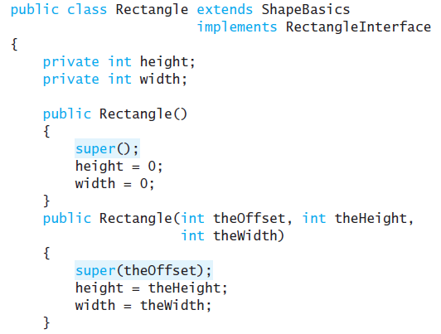
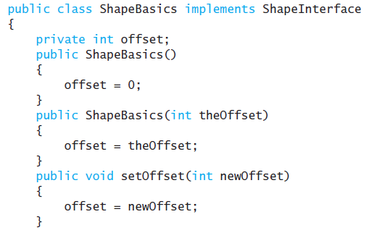
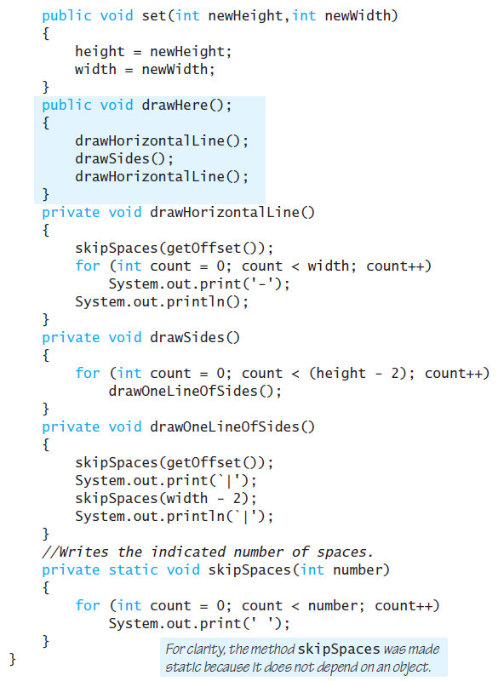
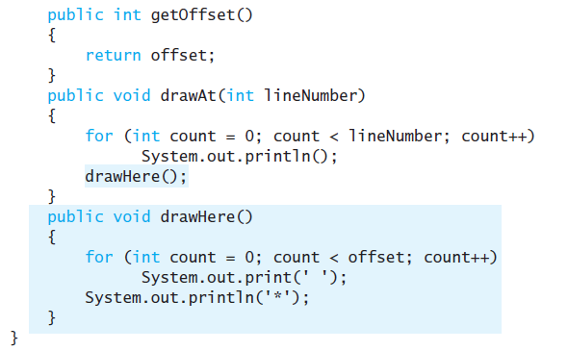
Case Study

Slide 19
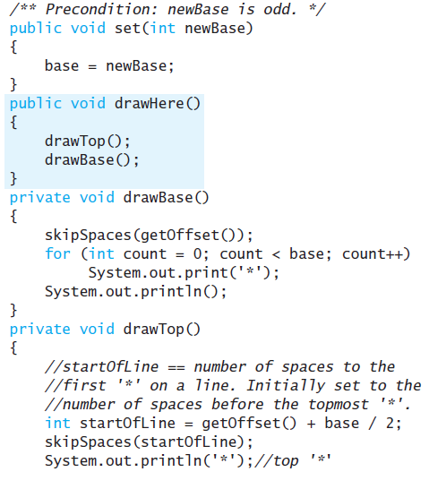
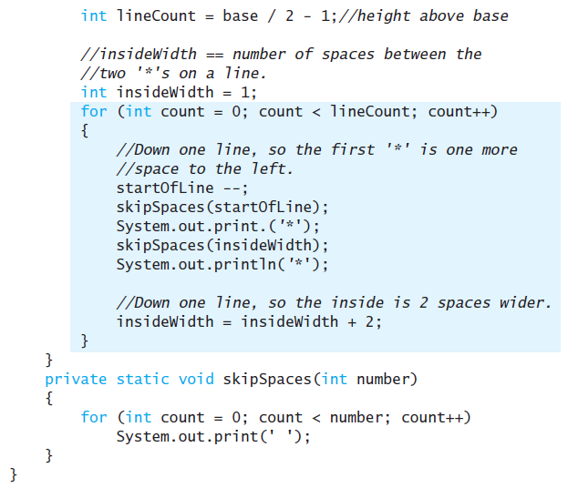
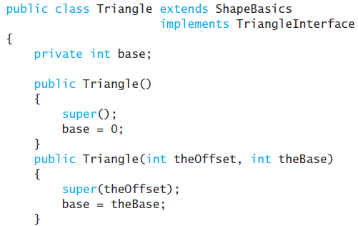
Case Study

Slide 20
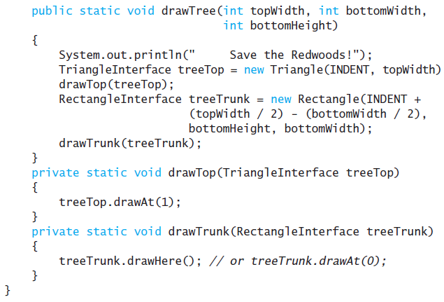
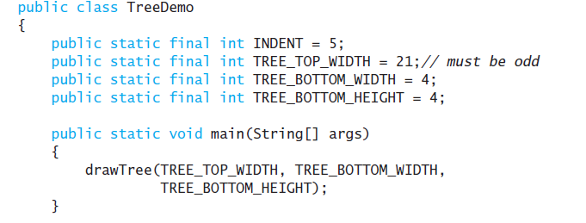
Case Study

Slide 21
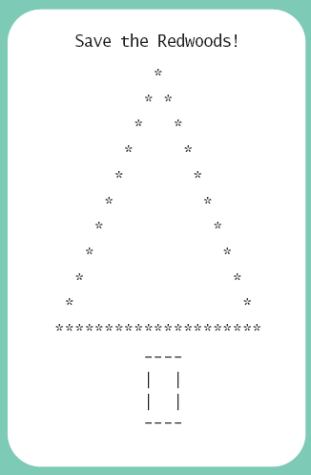
Case Study
Sample
screen output

Slide 22
The Comparable Interface
Java has many predefined interfaces
One of them, the Comparable interface, is used to impose an ordering upon the objects that implement it
Requires that the method compareTo be written
public int compareTo(Object other);

Slide 23
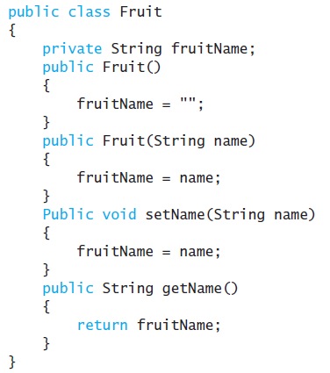
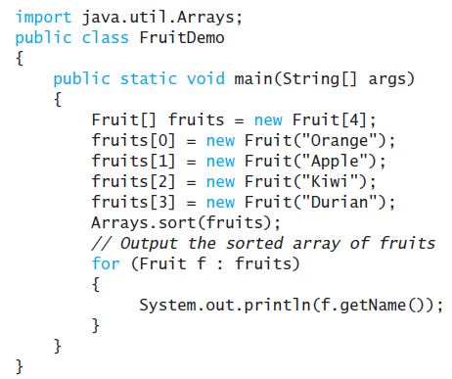
Sorting an Array of Fruit Objects
Initial (non-working) attempt to sort an array of Fruit objects
Result: Exception in thread “main”
  Sort tries to invoke compareTo method but it doesn’t exist

Slide 24
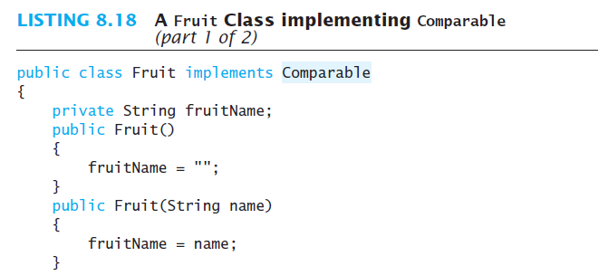
compareTo Method

Slide 25
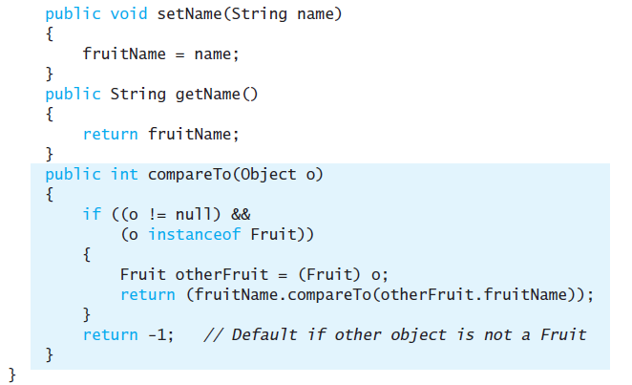
compareTo Method

Slide 26
Abstract Classes
Class ShapeBasics is designed to be a base class for other classes
  Method drawHere will be redefined for each subclass
  It should be declared abstract – a method that has no body
This makes the class abstract
You cannot create an object of an abstract class – thus its role as base class

Slide 27
Abstract Classes
Not all methods of an abstract class are abstract methods
Abstract class makes it easier to define a base class
  Specifies the obligation of designer to override the abstract methods for each subclass

Slide 28
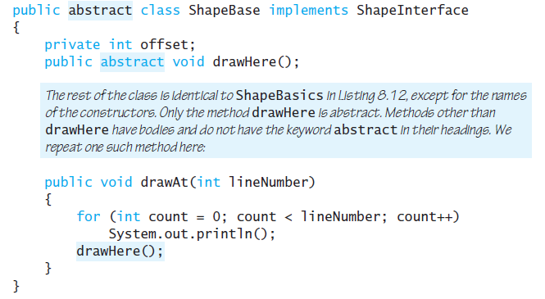
Abstract Classes
Cannot have an instance of an abstract class
  But OK to have a parameter of that type
  abstract class ShapeBase

